Slide 1
Emerging Concepts and Technologies (ECT) Research Program
Introductory Webinar for Program Applicants
1 June 2023
Notes:
This webinar is being recorded so that those unable to attend can review the material. The webinar and my presentation notes will be posted on our website www.netzeroatlantic.ca/ECT following today’s presentation.

Slide 2
Outline
Webinar Purpose / Program Need
Strategic Objectives
Project Objectives: Two Funding Streams
Applicant Guide
Eligible Applicants
Research Funding Streams
Priority Research Themes
Eligible Activities and Expenditures
Evaluation Criteria
General Expectations
Key Dates:
Call Opens: 21 June 2023; Proposals due Monday 17 July 2023 (11:59 ADT) – 26 days
Key Documents:
Applicant Guide / Submission Templates / FAQ: www.netzeroatlantic/ECT
Notes:
Webinar purpose: to introduce the ECT Research Program, application process and Program expectations to permit questions and clarifications in advance of the launch of the first call (opens June 21 – closes July 17). As noted, this webinar is being recorded and will be posted on our website later today. A second recorded webinar will be held the week leading up to June 21 – it will be exclusively Q&A with minimal presentation material. More on that later.
I should point out that everything discussed today is contained in the Applicant Guide posted late yesterday on the Program website, along with Proposal and Budget Submission Templates and the FAQ.

Slide 3
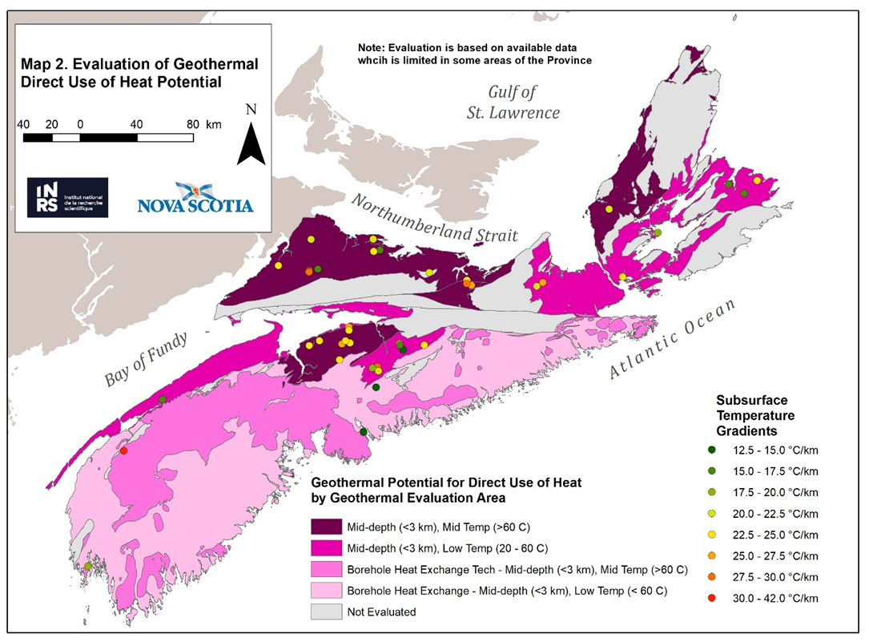
Program Need
R&D investments are required in two areas:
Fostering early-stage genesis of novel technologies, methods and practices in Nova Scotia, and
Evaluating the suitability for Nova Scotia of technologies, methods and practices emerging from other jurisdictions.
By investing now in R&D:
Nova Scotia will have the solutions we need when we need them.
Nova Scotia-grown solutions will contribute to economic development and new opportunities for Nova Scotians.
Net Zero Atlantic will manage $3M over 3 years from the Nova Scotia’s Green Fund (revenue collected under the Province’s cap-and-trade program) to research natural carbon sinks and invest in research needed for new clean technologies and practices to help us meet our net-zero target by 2050 (Actions 13 and 63 of Nova Scotia’s Climate Change Plan for Clean Growth.
Notes:
The province is already investing in three proven paths to GHG reduction: greening the electricity sector, improving building efficiency, and EVs. These investments will help us meet our 2030 goals. But hard-to-abate emissions will remain in several sectors in the 2030-2050 period. The ECT Research Program is aimed at those emissions and those other sectors, as well as remaining emissions in the sectors just noted (electricity, buildings and EV adoption).
The green box explains that this 3-year funding originates from the province’s Department of Environment and Climate Change. Additional funding may obtained from other sources for the subsequent Sept 2023 and June 2024 calls; but since no funding has yet been announced, no details can be discussed today. But It’s important to recognize that this Program may evolve not just in available funding, but the Priority Research Themes as well as the application/evaluation guidelines may change for subsequent calls depending on submissions received. So please check the website for updated reference documents, FAQs, etc. prior to subsequent calls.

Slide 4
Net Zero Atlantic’s Strategic Objectives
Identify knowledge gaps to eliminate or offset the final 20% of GHG emissions (2030-2050);
Advance promising technologies and approaches that can address the gaps to net zero;
Encourage collaborative research among Nova Scotia’s universities and community colleges, Indigenous-led institutions, the private sector and others;
Generate intellectual property that has the potential to address global demands for low-carbon solutions; and,
Foster thematic research networks that attract foreign investment.
CORE PROGRAM OBJECTIVES
Reduction of hard-to-abate GHGs in Nova Scotia
Intellectual Property / economic development opportunities for Nova Scotians
Applicants should consider these broad strategic objectives when formulating their projects
Notes:
These are not necessarily the Proponent’s project objectives – they are Net Zero Atlantic’s ECT Program objectives .
We are trying to feed projects into the province’s incubator ecosystem. We’re trying to find projects (emerging concepts and technologies) that can’t easily find funding elsewhere because they’re too early stage. We are funding proponents to elaborate their ideas, build them up, then push them forward for further funding.

Slide 5
Eligible Applicants
The Proponent / Lead Applicant / Principal Researcher must be Nova Scotia based; partners can be based elsewhere in Canada or internationally (no weighting difference)
For-profit and not-for-profit organizations (academic institutions, companies including sole proprietors, industry & research associations, utilities, etc.
Indigenous organizations and groups
Community groups
Not eligible to receive funding: Government departments and agencies
Collaboration is encouraged and weighted but not excessively – we want good ideas and achievable project outcomes
Notes:
The Proponent / Lead Applicant / Principal Researcher are used interchangeably
There is no weighting difference in the Evaluation Criteria between a team with a Nova Scotia lead and Nova Scotia partners vs a team with a Nova Scotia lead and partners based elsewhere in Canada. I’ll just circle back to the Core Project Objectives: reductions in NS GHGs (post 2030) and economic opportunities for Nova Scotians.
NZA will only issue one contract per project – to the Lead Applicant. Lead Applicant is responsible for sub-contracting to partners and managing their participation in the project.

Slide 6
Research Stream 1
The Silver Dart in flight over the frozen Bras d'Or Lake on Cape Breton Island
Novel Technology, Methods, and Approaches Development in Nova Scotia
Pre-commercial conceptual projects that create made-in-Nova Scotia GHG reduction technology and approaches
Up to $50,000 (not including Mitacs); 12 months duration
Successful projects (those that advance NS’ progress to net zero and describe a path to IP and/or economic development) are eligible for follow-on funding up to $250,000 ea.
Follow-on projects must finish within the 3-year funding window
Follow-on projects must further advance their proof of concepts to a point where they can attract private sector or additional public sector funding.
Notes:
There are two Research Streams each with different objectives, funding totals and project durations. Stream 1 is for pre-commercial conceptual projects that create made-in-Nova Scotia GHG reduction technology and approaches. The emphasis in Stream 1 is made in Nova Scotia technology and approaches.

Slide 7
Research Stream 2
Novel Technology, Methods, and Approaches Adoption from Elsewhere
Stream 2 will fund technoeconomic and/or feasibility type studies that evaluate how technologies, methods, and/or practices under development outside of Nova Scotia can be imported and deployed, with or without modification, in the Nova Scotia context.
Technology adoption contributes to economic development through revenue generation and job creation; innovations can reduce costs, improve performance, demonstrate a new application and may increase export potential
Up to $130,000 not including Mitacs; 18 months duration
No follow-on funding allocated
Source: European Space Agency, Technology Transfer https://www.esa.int/
Notes:
Mitacs: The ECT Research Program is pre-approved for Mitacs funding through a Mitacs Accelerate Umbrella Grant, and NZA qualifies as a partner organisation. Mitacs matches funding from partner organisations to support university and college student hires.
This means that part of the funding granted by NZA through the ECT Program can be directed by NZA to Mitacs; Mitacs in turn will match that funding and give it to the Applicant, which increases the total project budget. Both private sector and academic institutions are eligible. The Proposal Submission Template has a section for Mitacs – but note the student(s) must be named/secured at the time of application.

Slide 8
Priority Research Themes
Fishing and Ferry Fleets
Nature Based Solutions for Carbon Sequestration
Agricultural emissions
Direct Air Capture
Long-term Energy Storage
Electricity System Challenges Post 2030
Notes:
For this initial call, we’ve identified the following PRTs to guide project applications. Please see Appendix 1 in the Applicant Guide for more detail. The important point is that we’re not trying to limit what can be proposed within these Themes but there is a method: the proponent must identify a knowledge gap within a theme and explain how addressing that gap (their project) will ultimately reduce GHGs in Nova Scotia and result in IP and/or economic development opportunities in Nova Scotia.
Importantly - these themes will change over time – and if you project doesn’t fit into one of these themes, please feel free to suggest other themes at info@netzeroatlantic.ca so we can include your theme in future calls. I can’t promise it will be included but I can promise it will be considered.

Slide 9
Eligible Activities
Essentially any activity directly related to the project and dissemination of its outcomes.
Research, development, assessment, data gathering, testing, modelling
Pre-demonstration field testing
Modification of existing processes, equipment, or systems
Cost assessments for the engineering, design and permitting
Notes:
Although modest conference and similar expenses are permitted, we naturally don’t wish to see funding spent on travel to exotic destinations. The objective of dissemination activities is to promote project outcomes locally and nationally so that additional funding can be secured from the private and public sector technology incubators.

Slide 10
Eligible Costs and Expenditures
Will fund up to 100% of eligible projects costs
In-kind costs are not reimbursable
Salaries and Benefits (Lead Applicant only)
Contracting Services (incl. partners)
Capital Expenditures (Lead Applicant only)
Results Dissemination/Travel (Lead Applicant only)
Other Expenses(Lead Applicant only)
Overhead (Lead Applicant only)
Taxes (Lead Applicant only)
Notes:
100% funding means that leverage including in-kind is not required; but leverage is weighted but again not excessively so. If you look at the Evaluation Criteria, projects are competing based on the project concept and outcomes, not on leverage and not on total project cost.
These are the categories in the budget template and they are applicable only to the Lead Applicant since partners would be listed under Contracting Services / Partners.
Add more lines under Contracting Services / Partners to explain how funding will be broadly allocated to partners (salaries, overhead, etc.). This section does not require the same detailed cost breakdown as needed from the Lead Applicant but sufficient detail should be provided to demonstrate ‘value for money spent’. Again, projects are not competing on total project cost but rather on concept, ability to deliver (team) and value for money. NOTE there is a non mandatory budget planning tool on the website that might be helpful to think thru how the project will be budgeted and delivered.

Slide 11
Equity, Diversity, Inclusion and Accessibility
Research must support the pursuit of equity, diversity, inclusion, and accessibility (EDIA) in both research practice and in research project design.
NZA will track and report ECT Research Program EDIA outcomes to the Program funders
These terms are further defined in Applicant Guide
The Proposal Submission Template includes a set of brief questions that will guide the Applicant:
To support EDIA in research practice, proponents must take steps to consider EDIA in the hiring and management of their research teams.
To support EDIA in research design, proponents must ensure that they have taken EDIA concerns into consideration in the design and implementation of their research projects (i.e., potential impacts of a project on equity-seeking communities).
Proponents will further be expected to report on EDIA outcomes at project close.
Notes:
NZA has developed and equity, diversity, inclusion, and accessibility Framework for the ECT Research Program which establish procedures and accountability mechanisms that Net Zero is subject to. With respect to Project Proponents, the EDIA Framework is not prescriptive; rather it sets an expectation that EDIA will be considered and reported.

Slide 12
Evaluation
Notes:
This taken from the Applicant Guide. I just want to point out that 60% of the total scoring is related to the project concept and methodology (and your ability to describe these aspects) plus another 15% is related to the delivery team. You can see that Collaboration is listed under section 3 while leverage is listed under section 4. They are evaluated but are not significantly weighted. And you’re not competing on price either – but value is important. I repeat: we’re looking for good project ideas with a solid plan to achieve project objectives; projects that align with program and stream objectives and that will result in GHG reductions and economic benefits in NS.

Slide 13
General Expectations
Methodology and Schedule will be used in the Contract
Final report will be posted on NZA website / IP
Dissemination plan
Proponents to deliver a webinar at NZA’s monthly webinar series
Please assemble everything in a single PDF
Include supporting docs if applicable
Key Dates:
Call Opens: 21 June 2023; Proposals due Monday 17 July 2023 (11:59 ADT) - 26 days
Key Documents:
Applicant Guide / Submission Templates / FAQ: www.netzeroatlantic/ECT
Notes:
Two things to say about Intellectual Property (IP): (1) Net Zero Atlantic does not desire ownership or IP rights but we do require the ability to circulate/post project reports on our website. Licencing agreements, if needed, may be required on a project-by-project basis (to be discussed at the contracting stage). Bottom line: we’re respectful of IP and pre-publication confidentiality.
(2) The ECT Program strongly favours IP development and economic development outcomes in NS. When considering the role of non-NS project partners, be wary of scenarios when partners receive funding to develop IP but the IP ultimately ends up serving the economic interests outside of NS. Proponents need to demonstrate how NS will benefit from the project. We have no problem funding partners outside of NS as long as Nova Scotians will see the benefits of that funding in future.
Dissemination Plan: the dissemination of project outcomes to what I broadly call “knowledge consumers” is an important outcome of the ECT Program. Well planned dissemination can stimulate network formation, build HQP capacity, and most importantly generate investor interest and attract additional funding. So it’s important to describe how the proponent plans to disseminate research. That said, final plans will be discussed with proponents on a project-by-project basis: not all results should be widely disseminated if for example, results are confidential or if projects can’t be completed as planned.

Slide 14
Final Thoughts
I am the Project Administrator – but please no calls or direct emails
Please send in your questions to info@netzeroatlantic.ca so we can update the FAQ
No calls / emails to DEEC
All documents are on the website (https://netzeroatlantic.ca/ect) including this webinar
Final Draft Applicant Guide
Final Draft Proposal Submission Template
Final Draft Budget Submission Template
FAQ will be updated regularly (and will contain all past questions)
Work Scope Task Support_Non Mandatory.xls
Follow up Q & A Webinar week of June 12 (date TBD)
Notes:
All docs currently labeled “Final Draft” on our website are available for comment and will be finalized when the call opens on June 21. We aren’t expecting many changes but there may be some based on feedback received. So you can begin to conceive your projects using the Applicant Guide and submission templates already available.

Slide 15
Questions
ECT Research Program Website (https://netzeroatlantic.ca/ect)
Please send in your questions to info@netzeroatlantic.ca
Follow up Q & A Webinar week of June 12 (date TBD)

